Slide 1

VILLAGE SCENARIO
Group 6

Slide 2
OUTLINE
GROUP MEMBERS INFORMATION
INTRODUCTION
PROJECT PROPOSAL
OBJECTIVE OF THE PROPOSAL
OUTPUTS
CONCLUSION

Slide 3
PRESENTED BY
EZAZUL ISLAM 18-38362-2
MOHAMMED IBRAHIM SHAWON 19-40767-2
INDROJIT DHE SHAON 18-38674-3
SAMIHA HOSSAIN 20-42435-1
COMPUTER GRAPHICS
SECTION H
Submitted To:
Aneem Al Ahsan Rupai
Lecturer, CS

Slide 4
INTRODUCTION
Our project is mainly scenario based. And the scenario is based on a normal village with 3 types of views of it. The scenario should also contain different type of objects. We wanted to draw the village because we wanted to show the things a village can contain and how they change as the views change. The problem needs to be solved by the OpenGL API and glut’s different library function and algorithms which has been learned on the theory classes.

Slide 5
PROJECT PROPOSAL
Our project is mainly based on a village scenario. We wanted to demonstrate a look of a village in a simple manner. The scenario contains different types of objects such as houses, trees, windmill, hills, river, boats, Christmas tree, sun and etc. The scenario also changes as time progress with three different effects for example sunny day, rainy day and night view. We wanted to use all of our knowledge gained through the course in our project. The project is based on opengl and glut we used mostly the primitive functions and algorithms to complete the project.

Slide 6
OBJECTIVE OF THE PROPOSAL
Our project is scenario-based. We can see many moving and unmoving objects in the scenario. The moving objects are ships, birds, clouds, sun, moon, horse-cart, windmill. And the unmoving objects are the hills, Shop, School, small village home, trees, Christmas tree and so on.

Slide 7
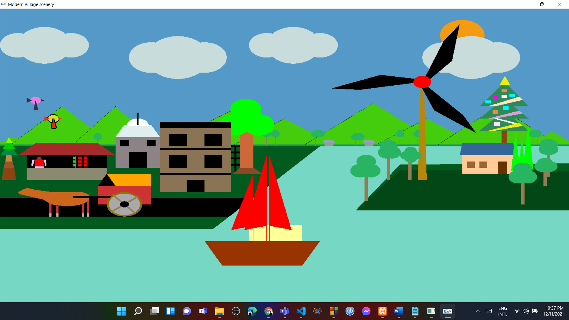
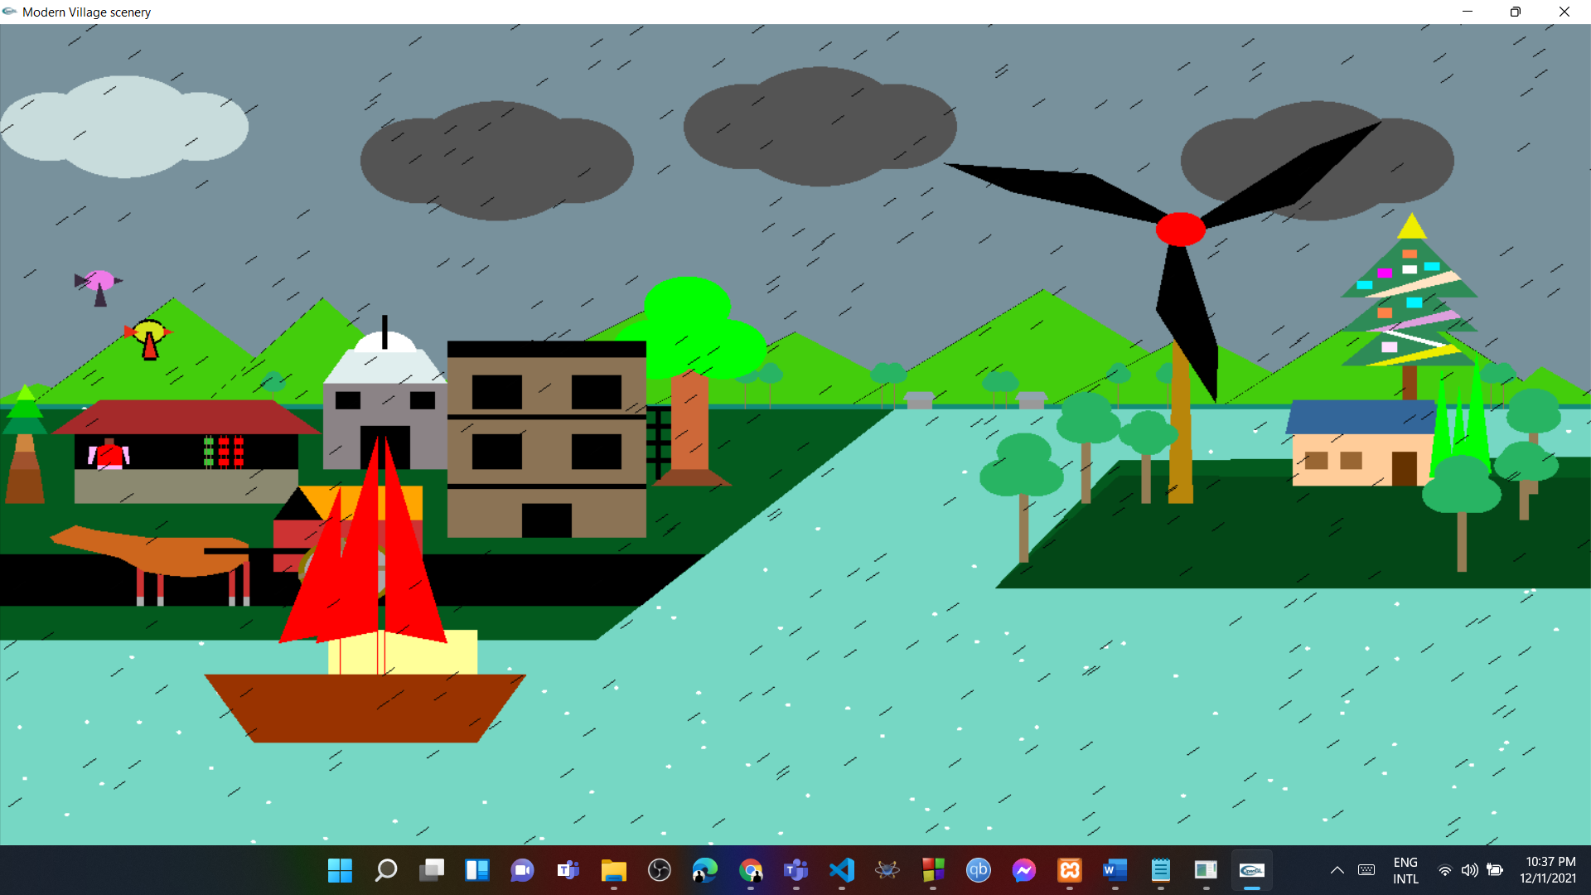
OUTPUTS

Slide 8
CONCLUSION
From this type of scenario, we can attract many tourists to visit these kinds of places and also some of the projects can be implemented for educational purposes.

